Slide 1
Lecture 26 (2) – Heaps and Heapsort
CST370 – Design & Analysis of Algorithms
Dr. Byun
Computer Science

Slide 2
Lecture Objectives
After completion of this lecture, you will be able to
  represent a heap in an array
  construct a heap of n numbers.

Slide 3
Priority Queue and Heap (Review)
Priority queue is an abstract data type with three primary operations.
  Finding the max item.
  Deleting the max item.
  Adding a new item.
Heap is a good implementation of priority queue.
70
30
50
10
20

Slide 4
Heap Representation in an Array
We can represent a heap with n nodes using an array of size “n + 1”.
  We do not use the index 0.
  We store the heap in the array from the index 1 to n.
    Root node is assigned to the index 1 of the array.
    All following nodes are stored from the index 2 to the index n.

Slide 5
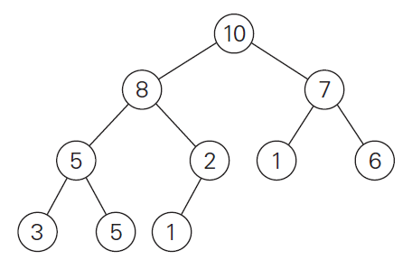

Heap Representation – Example
There are 10 nodes in the sample heap.
You store the heap in the array of size 11 (= from index 0 to index 10)
  Note that we don’t use the index 0.

Slide 6
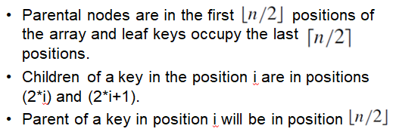
Heap Representation in an Array

Slide 7
Heap Construction
So far, we have assumed that the heap is already given.
But if we have n random input numbers, how can we construct the heap with the numbers?
One simple idea is to add n numbers one by one.
  We call it top-down heap construction.
Another idea is a button-up approach that offers better time complexity.
  We will talk about this approach in the class.

Slide 8
Heap Construction Example (1 of 5)
Assume that we have 6 numbers
  2, 9, 7, 6, 5, 8.
First, we should put the numbers in sequence like below.
2
9
7
6
5
8

Slide 9
Heap Construction Example (2 of 5)
From the result, we know that the nodes 2, 9, and 7 are parental nodes, which mean they have children.
  We start from the last parental node (= 7).
2
9
7
6
5
8

Slide 10
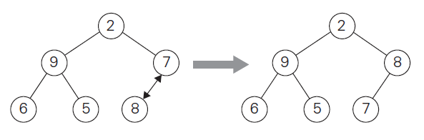
Heap Construction Example (3 of 5)
For the node 7, its child (= 8) is bigger than 7.
  Thus, we swap them (= “heapify”).

Slide 11
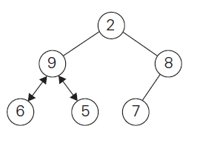
Heap Construction Example (4 of 5)
Since the next parental node is 9, we try to “heapify” at the node.
  But the number 9 is larger than its children 6 and 5, we don’t do any swapping.

Slide 12
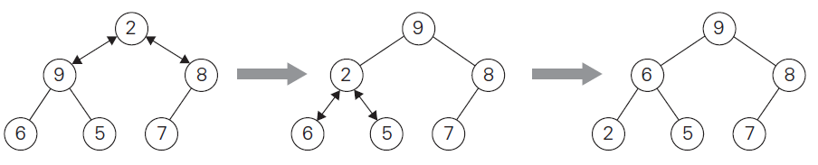
Heap Construction Example (5 of 5)
We should consider the last parental node 2.
  Since 9 is a bigger child, we swap 9 and 2.
  After the swapping, since 2 is less than its children, we need one more swapping.
  We swap 2 and 6 because 6 is bigger than 5.

Slide 13
Exercise
Construct a heap with the following numbers.
  1, 2, 3, 4, 5, 6, 7, 8

Slide 14
Additional Resource
If you need more info on the heap construction, watch this video:
  http://y2u.be/ixdWTKWSz7s

